Slide 1
Yoga and Mountaineering
The beauty lies in the walking and in the breathing
Bettina Boekle, November 2024

Slide 2
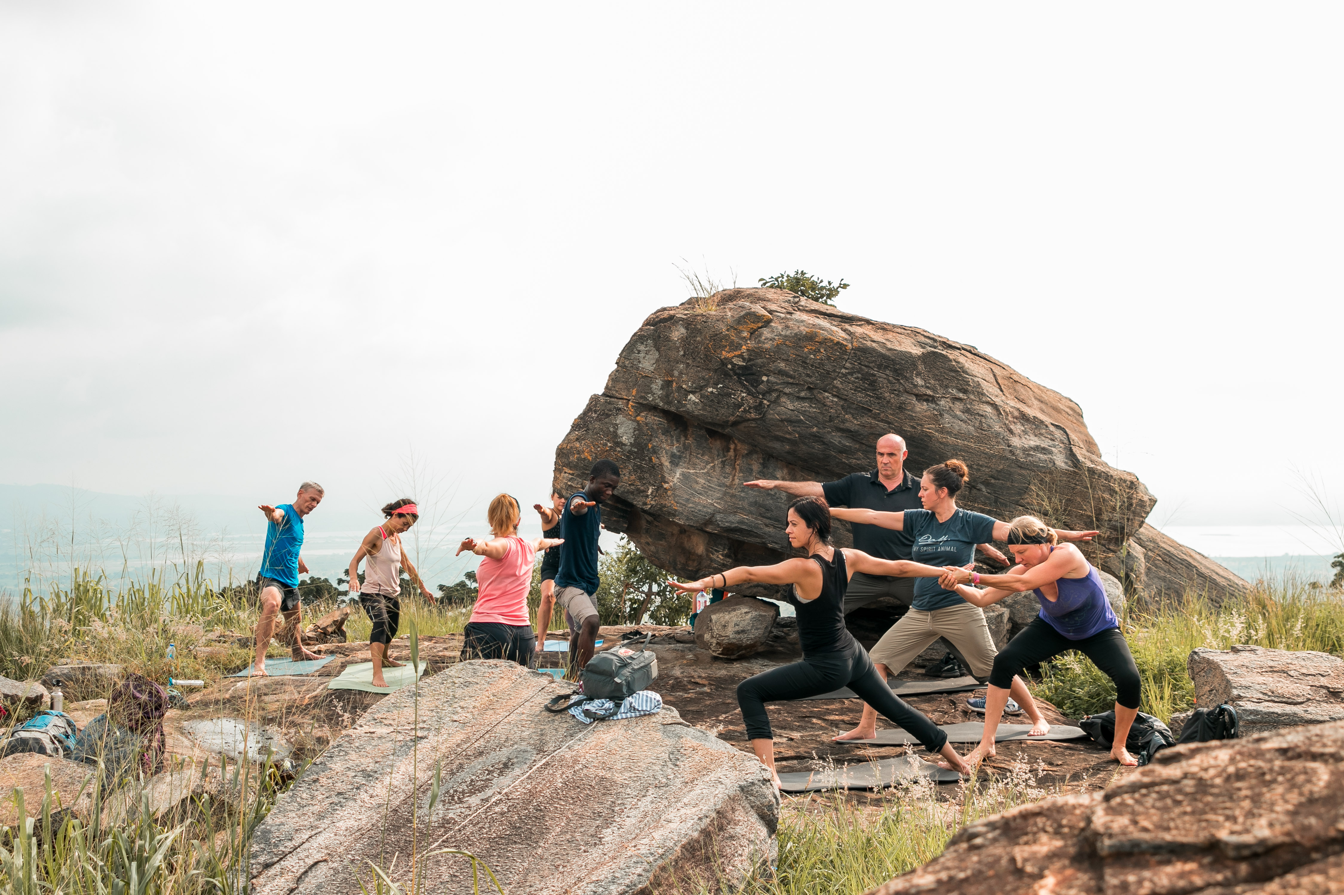
Why Yoga and Mountaineering?
Yoga means “union” – union of body, mind and breath.
Without breath, there is no yoga.
Without breath, no mountain can be climbed.
Climbing takes mental will. Focus on breathing helps to master challenging climbing situations.
Release stress in a natural environment
Calm your mind in nature
Stretch and release pain from your hiking day

Slide 3
Yoga while climbing Mt. Kilimanjaro – how?
Days up to the Roof of Africa are full: Pack your bag, breakfast, depart, walk, rest, eat and sleep.
We want to offer you physical relief from your hiking day with a daily yoga session focused on stretching the body, relieving common aches caused by long days and preparing you for a better night in the camp. A physically released body sleeps better.
Daily afternoon yoga routine after resting time in our yoga tent or outside will make a difference to your hike next day. We adapt what we do to what you need on any given day.
When you master your breath, you master your mind. Hence you will master the mountain.

Slide 4
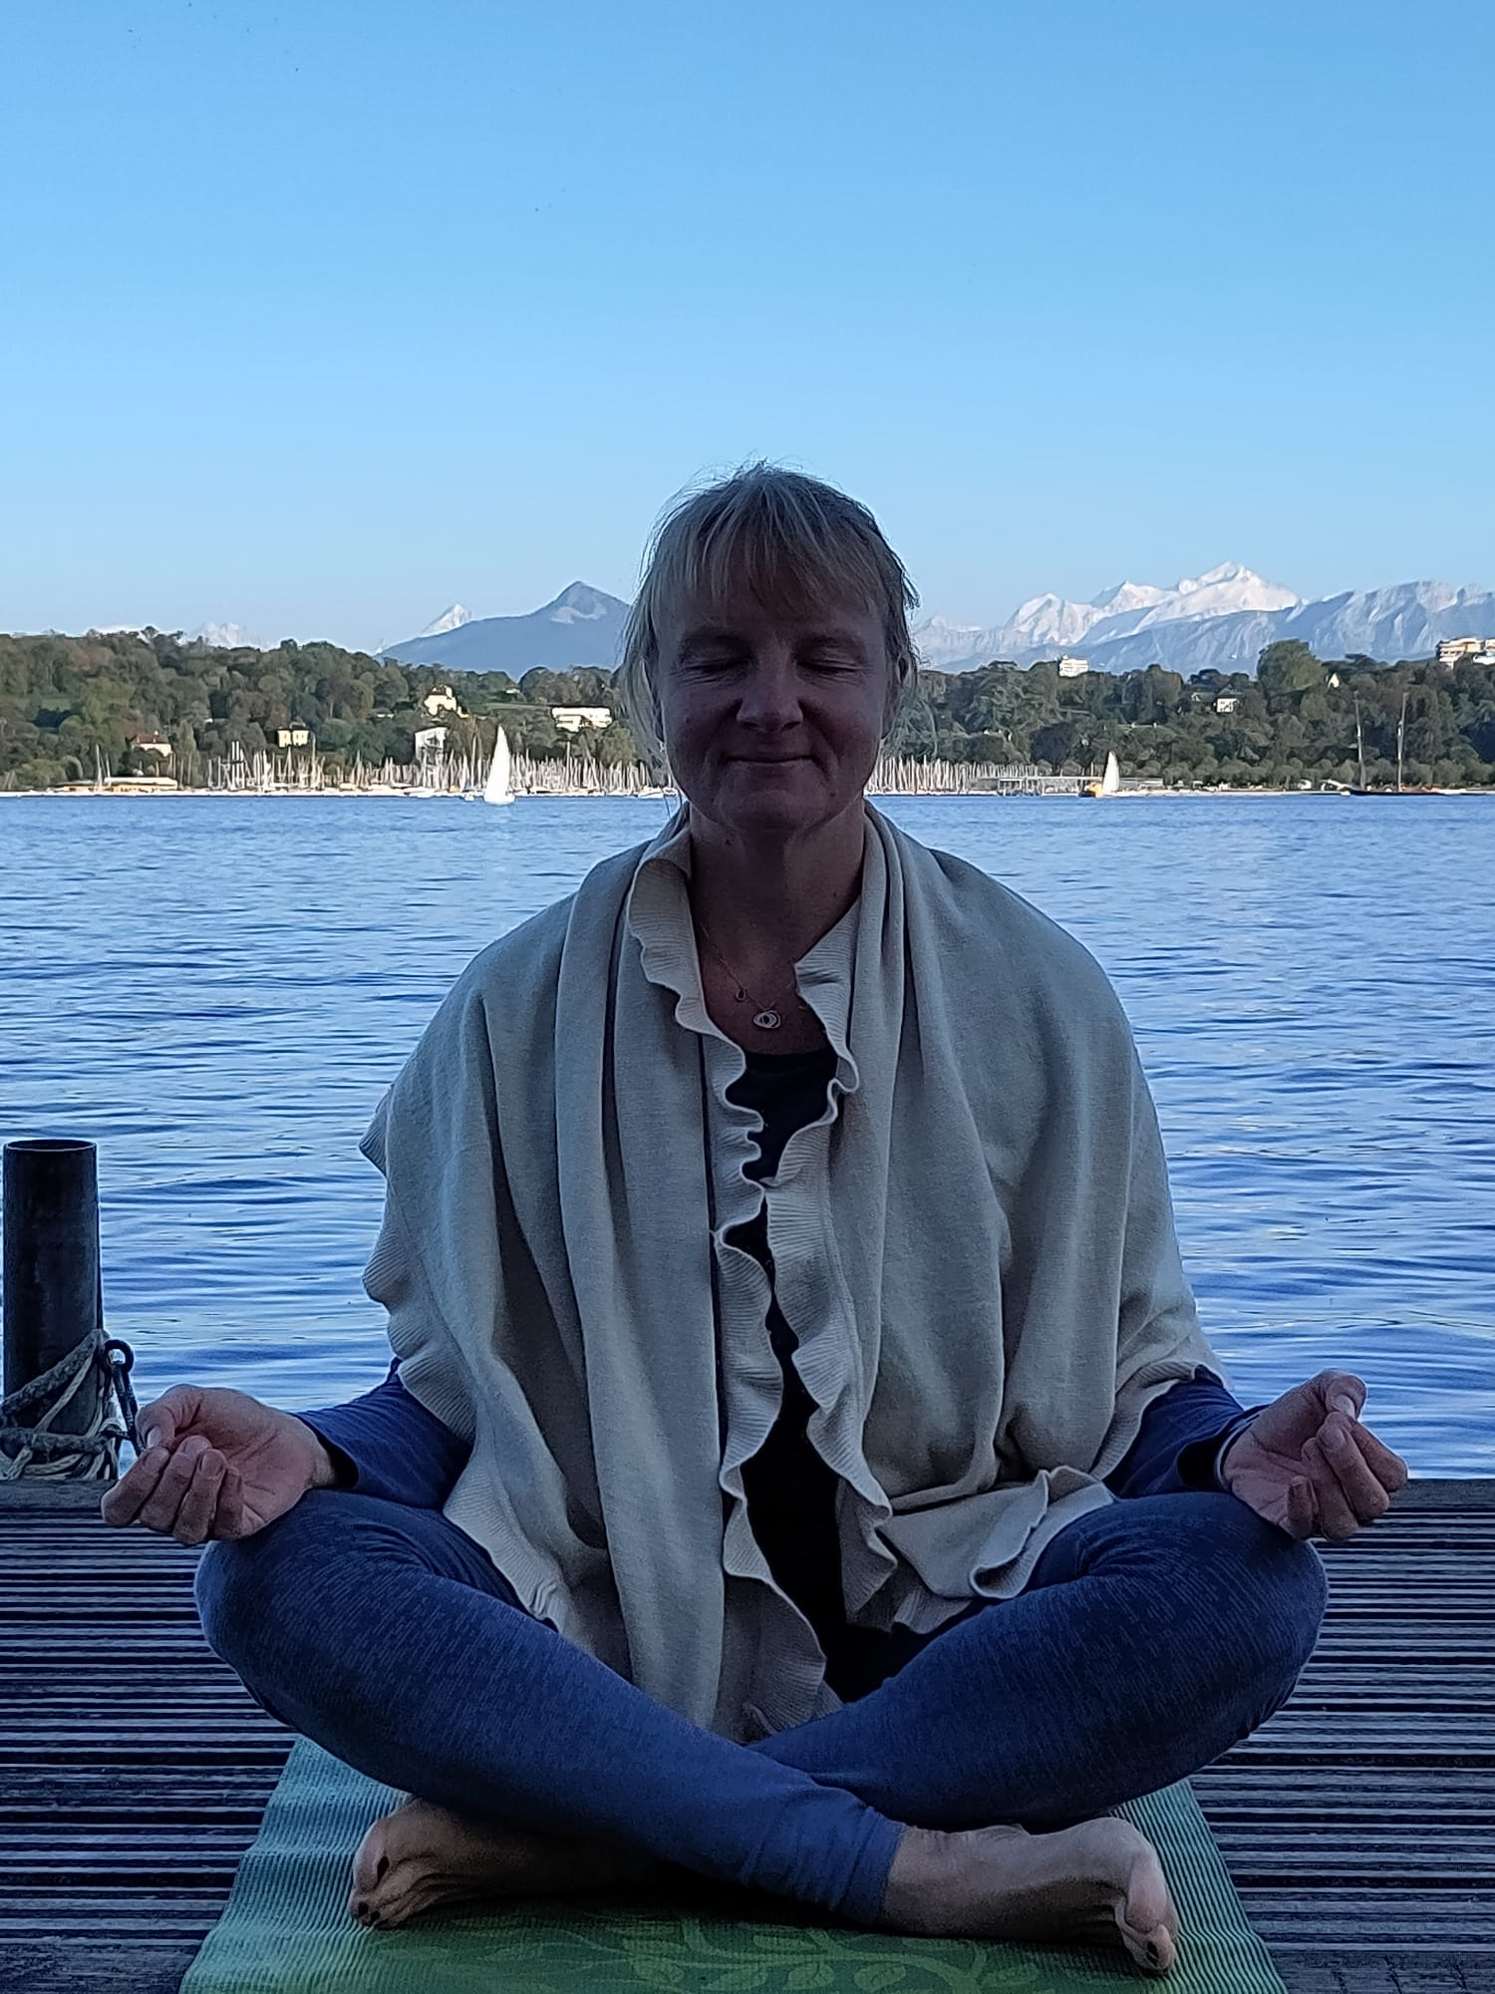
Bettina and her yoga journey
With the passion to unite body and mind through breathing, Bettina Boekle started her yoga journey more than 20 years ago and has practiced in Germany, Italy, Brazil, the United States, Ghana and Switzerland since then. Receiving her 200-hr Vinyasa (Flow)and Meditation training from Embrace Yoga DC with Faith Hunter, Bettina continues her daily individual yoga and meditation practice.
She is an outdoor-fanatic teaching yoga on the mountain, in the forest or on a Stand-up paddle board on water.
Bettina started yoga mid-20 to manage chronic back pain. Yoga has become her life-saver and helped her to manage physical and mental health crisis in her life. She believes that yoga is for anyone and indifferent of body size, shape and stage: It is about the attitude with which we approach our practice.

Slide 5
Walk with us. Breathe into what surrounds you. Master your mind and be yourself!

Slide 6
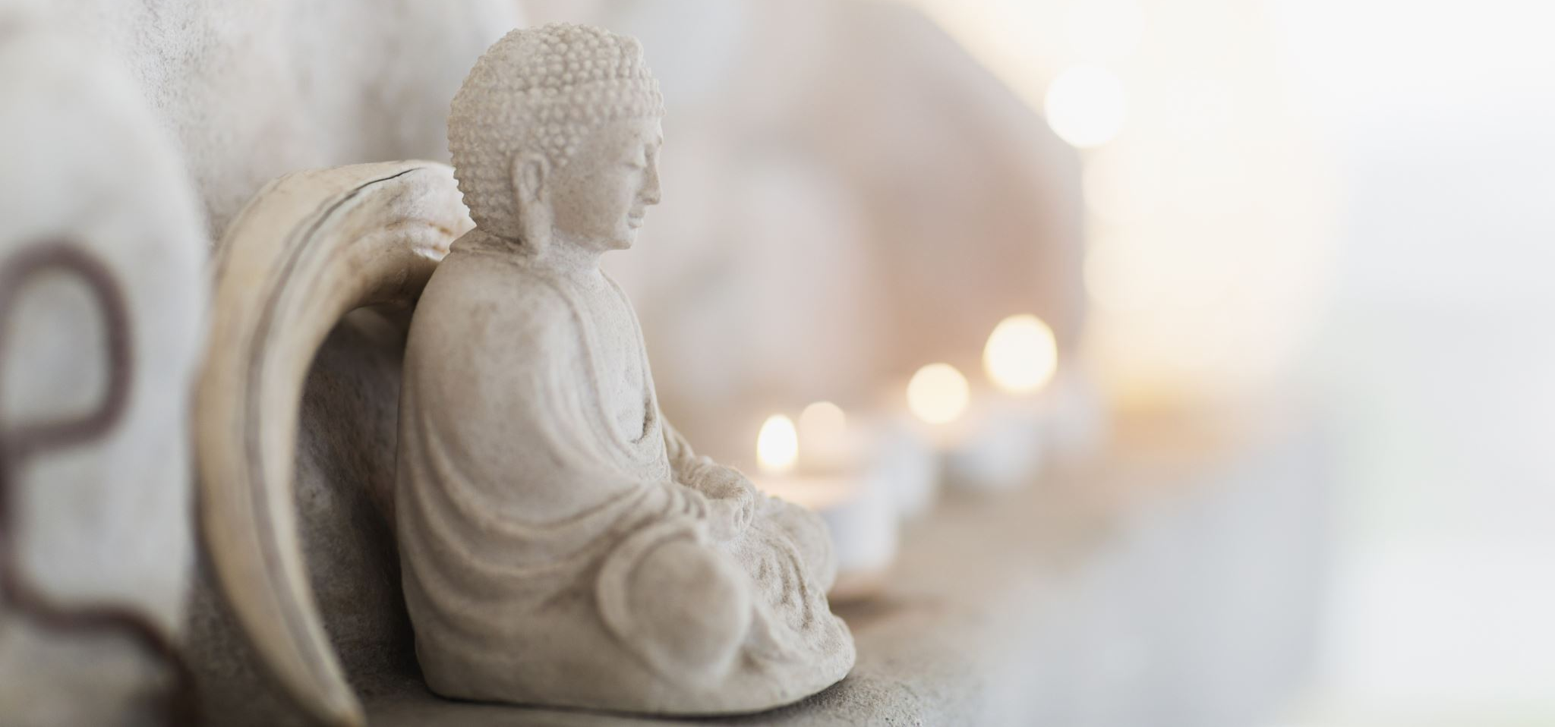
Namaste –
My inner light recognizes yours.

